Slide 1
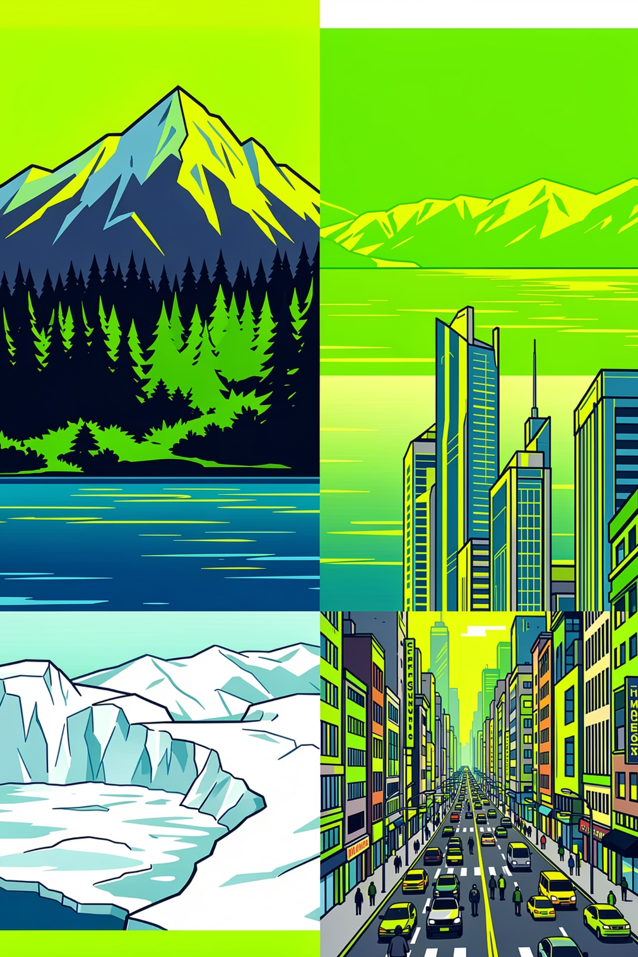
Deep Learning Project: Intel Image Classification
Name : Muhammad Umer & Muhammad Irtisam
Roll # : 23010112-005 & 23010112-006

Slide 2
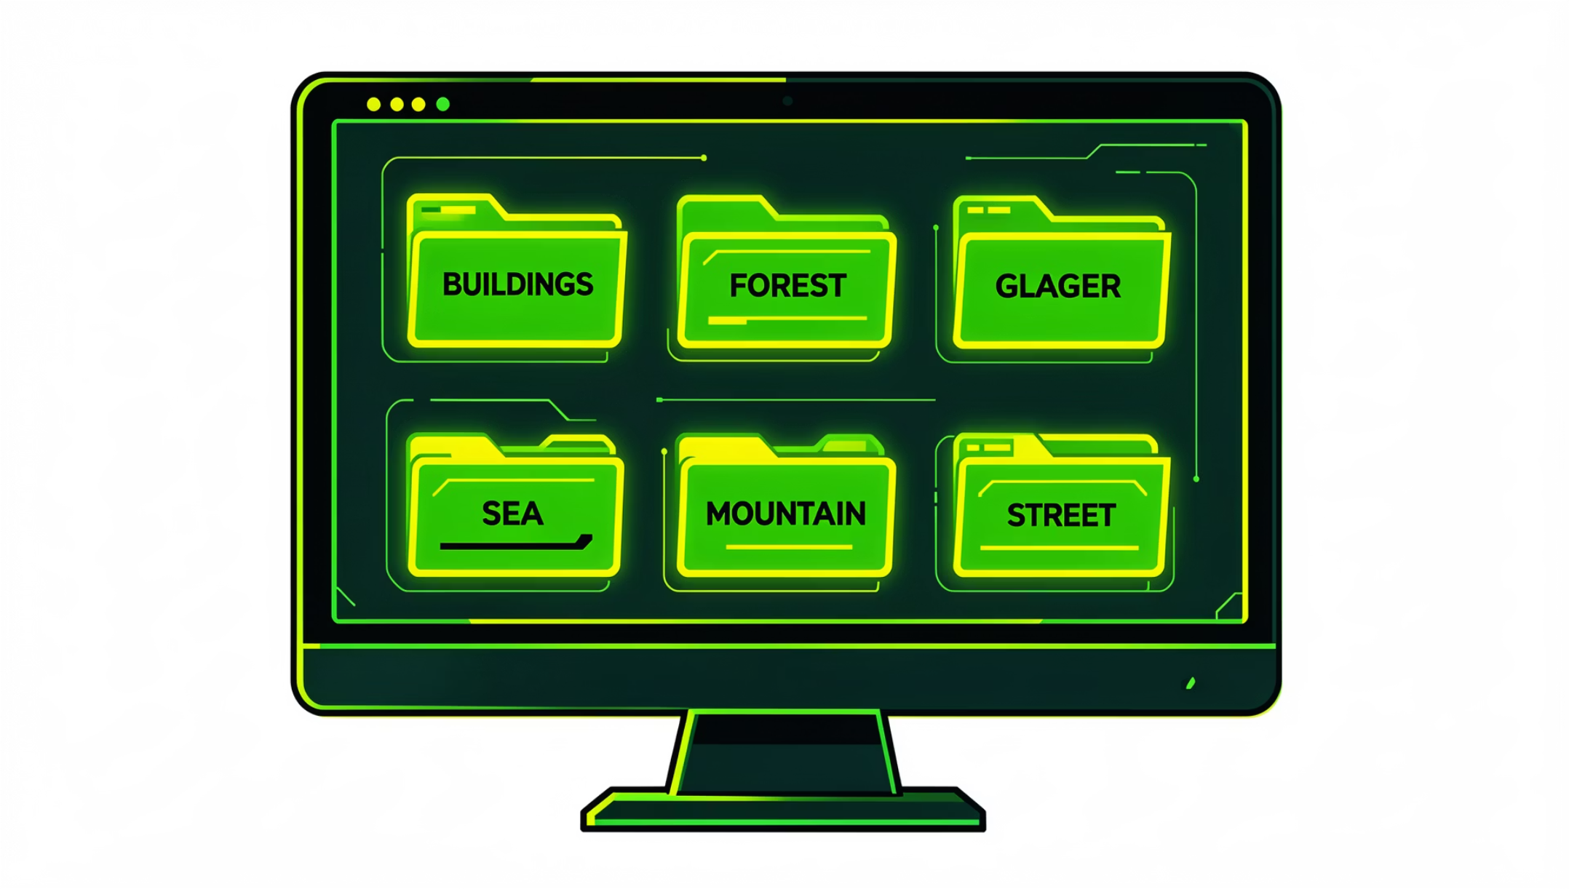
Dataset Overview
Key facts
Total images: ~17,000. Train ~14,000 | Test ~3,000. Six classes: Buildings, Forest, Glacier, Mountain, Sea, Street. Data structured by class folders for easy Keras loading.
Source: Kaggle — puneet6060 / intel-image-classification.

Slide 3
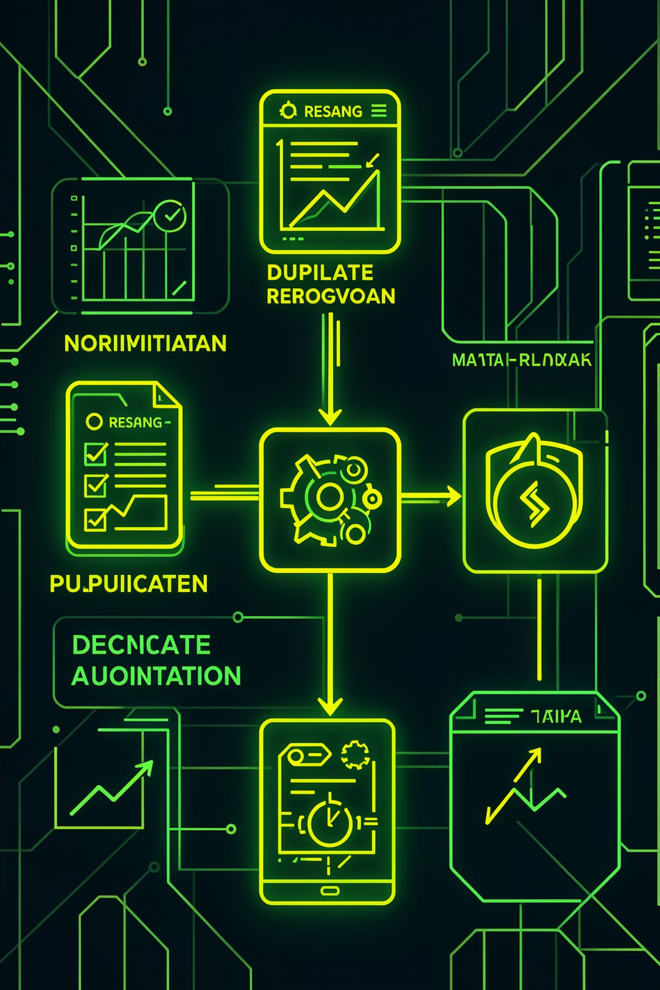
Data Preprocessing
Resize
Normalize
Duplicates
Images resized (e.g., 128×128) for fixed input and faster training.
Pixel values scaled 0–255 → 0–1 to stabilize training.
Remove duplicates to prevent bias and overfitting.
Augmentation
Rotate, zoom, flip, shift to increase diversity and robustness.

Slide 4
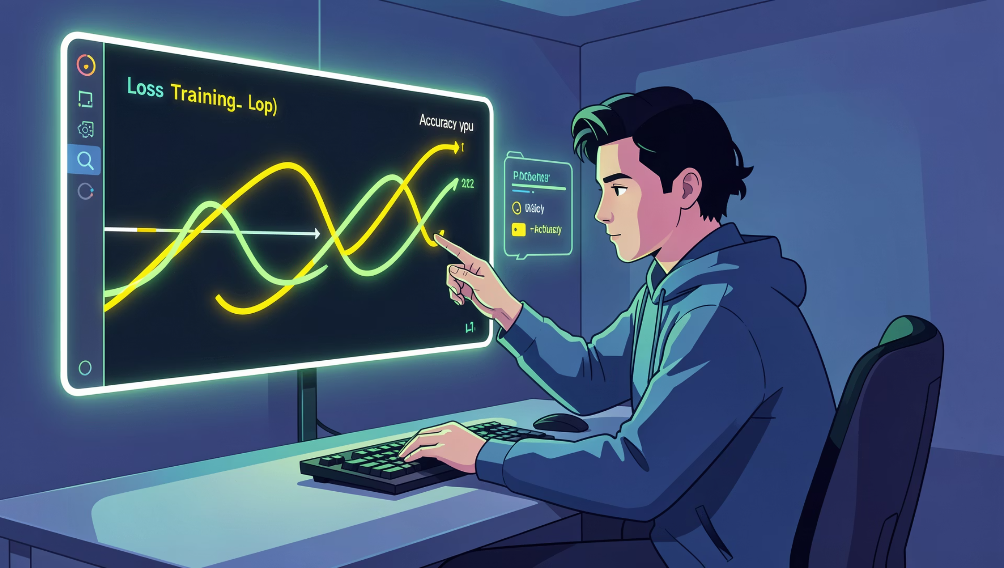

Modeling Pipeline
Models implemented: ANN, LeNet-5, AlexNet, Custom CNN, VGG16 (transfer learning). Training setup: categorical crossentropy, Adam optimizer, track accuracy. Evaluation: accuracy, precision, recall, F1-score.
Keep validation set for tuning; test set reserved for final evaluation.

Slide 5
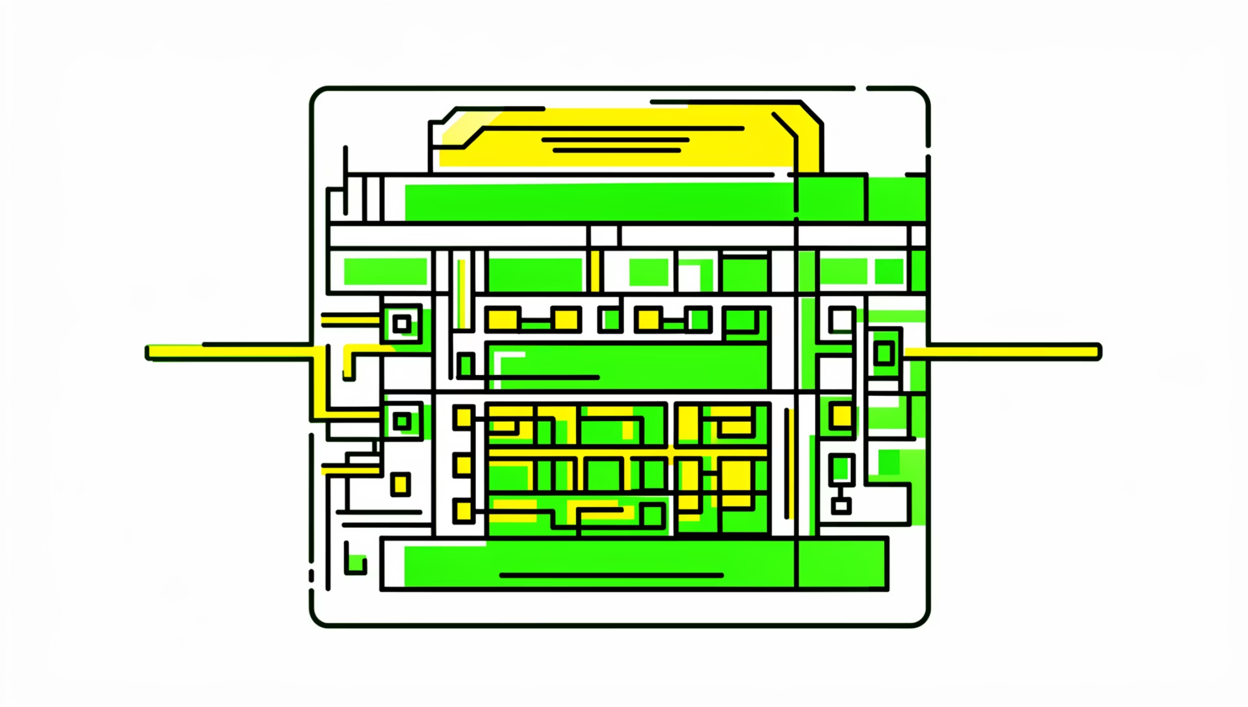
ANN: Baseline
Architecture & Results
Flatten → Dense(ReLU) → Dense(ReLU) → Softmax. Performance: moderate training accuracy, low validation accuracy. Metrics: lowest accuracy, precision, recall, F1.
Limitation: ignores spatial structure in images.

Slide 6
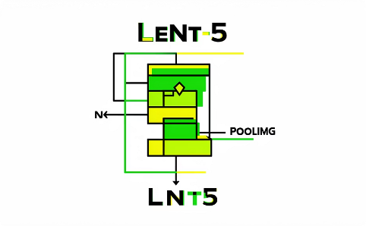
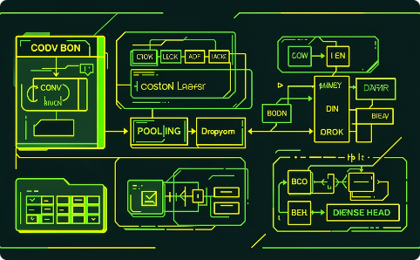
Convolutional Models: LeNet & Custom CNN
LeNet-5
Custom CNN
Classic CNN: conv → pool → dense. Improved accuracy over ANN by capturing spatial features.
Tailored depth and filters for dataset. Performance: better than ANN and LeNet; robust feature learning.

Slide 7
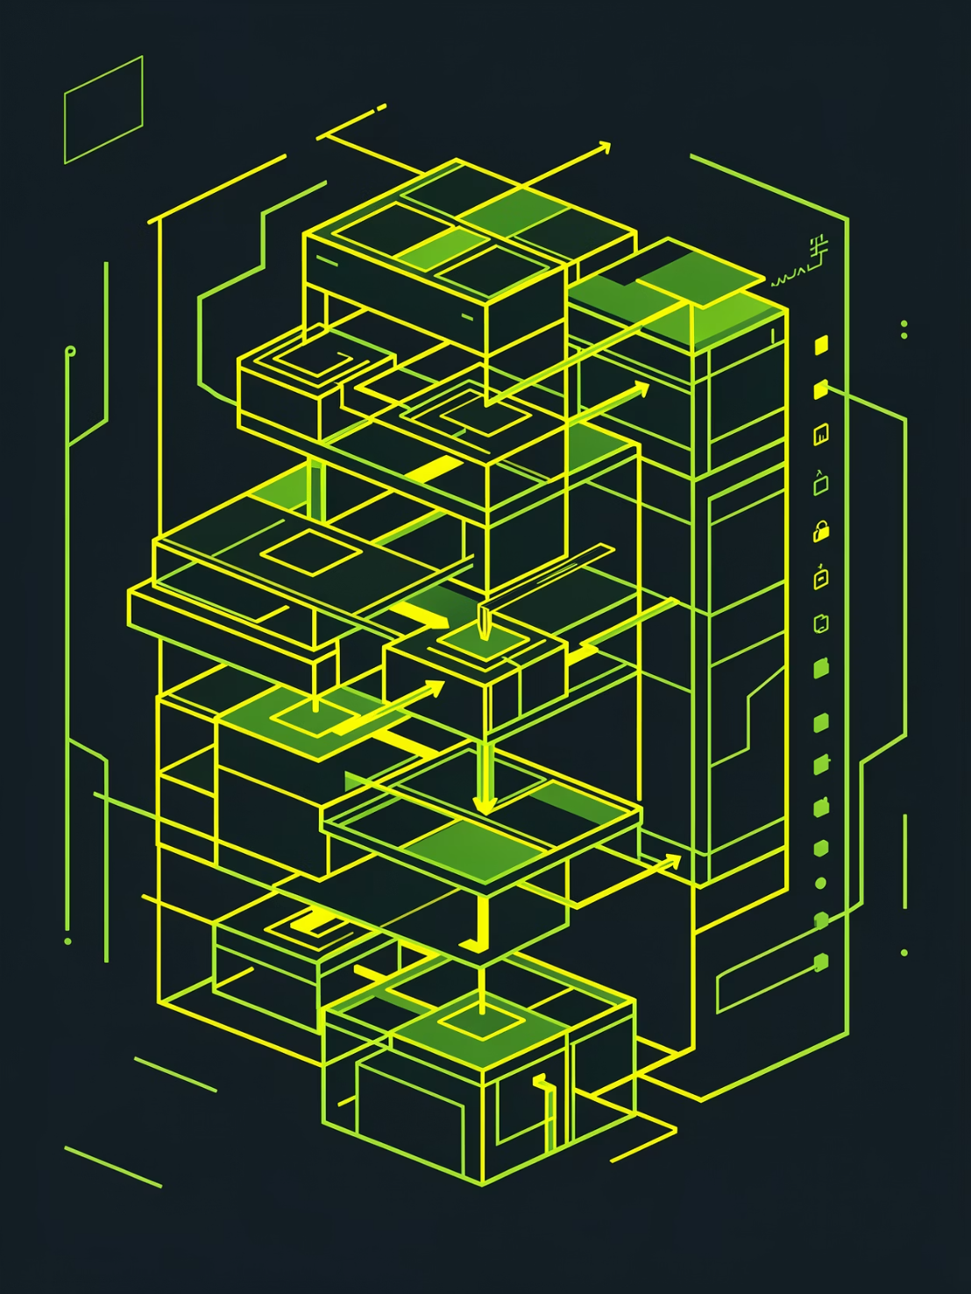
Deep Architectures: AlexNet
AlexNet: deeper conv stack, multiple filters and fully connected layers. Results: significantly higher accuracy, stable validation performance. Metrics: high precision, recall, F1. Training shows steady accuracy increase and stable validation curves.
Improvements: add batch normalization, longer training.

Slide 8
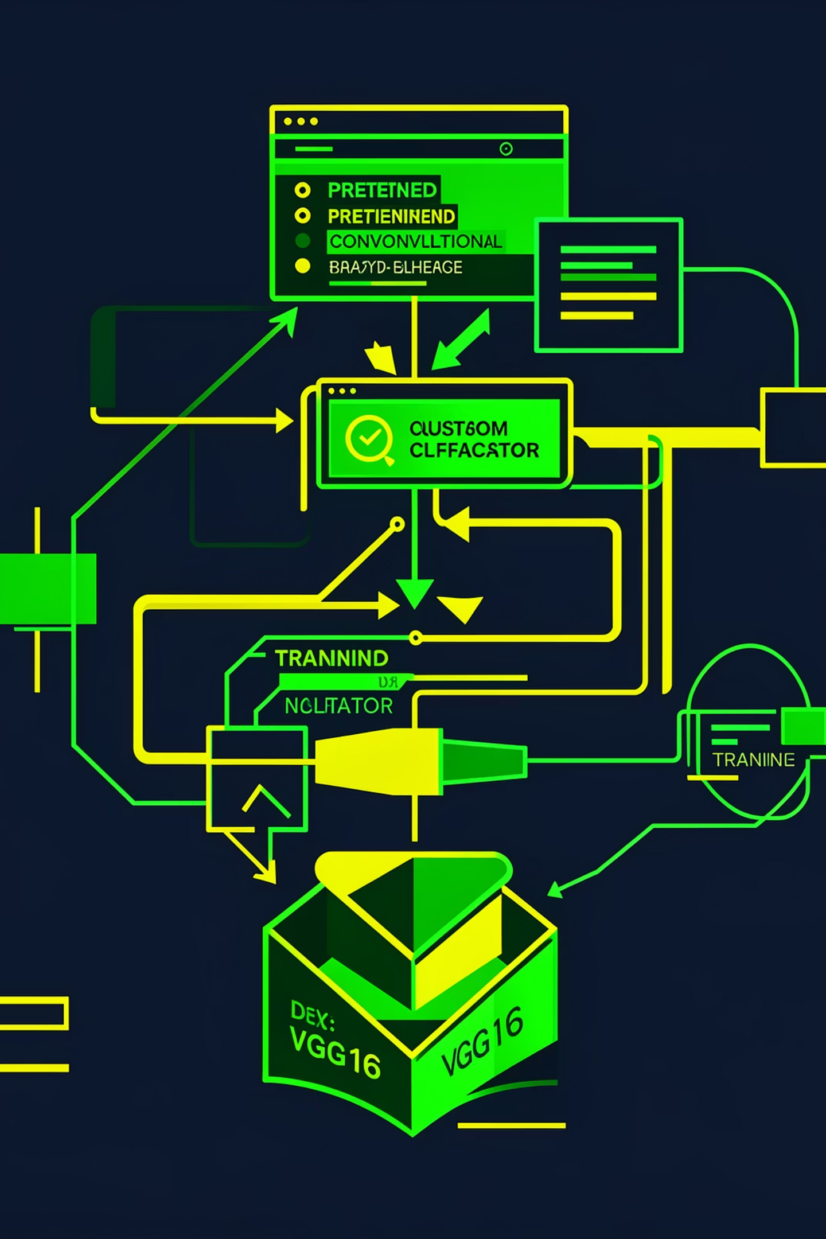
VGG16 (Transfer Learning)
Pretrained on ImageNet; frozen base + custom classifier. Achieved highest accuracy, precision, recall, and F1. Fast convergence and stable validation. Best feature extraction due to pretrained filters. Recommended next steps: fine-tune deeper layers and extend training.

Slide 9
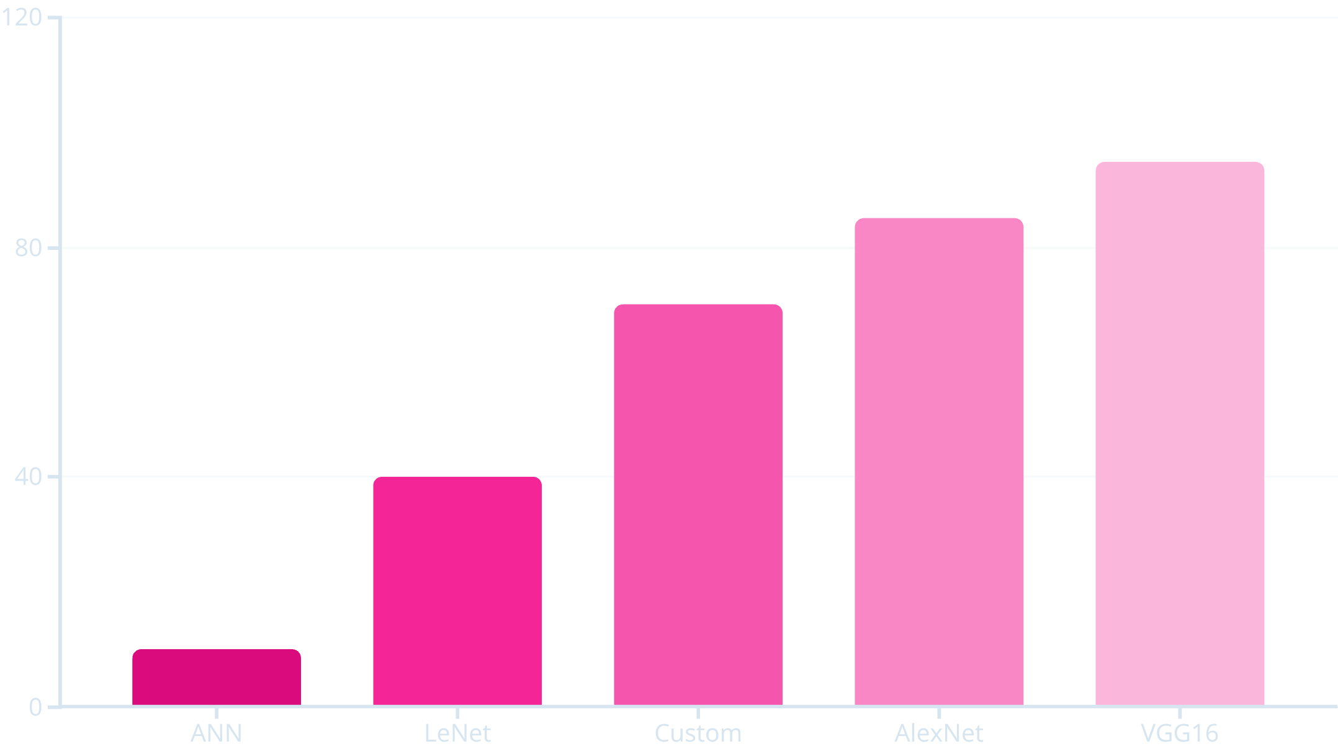
Evaluation & Comparison
Summary: ANN (lowest), LeNet (medium), Custom CNN (high), AlexNet (higher), VGG16 (highest). CNNs outperform ANN because they extract edges, patterns, and shapes—spatial features crucial for images.

Slide 10
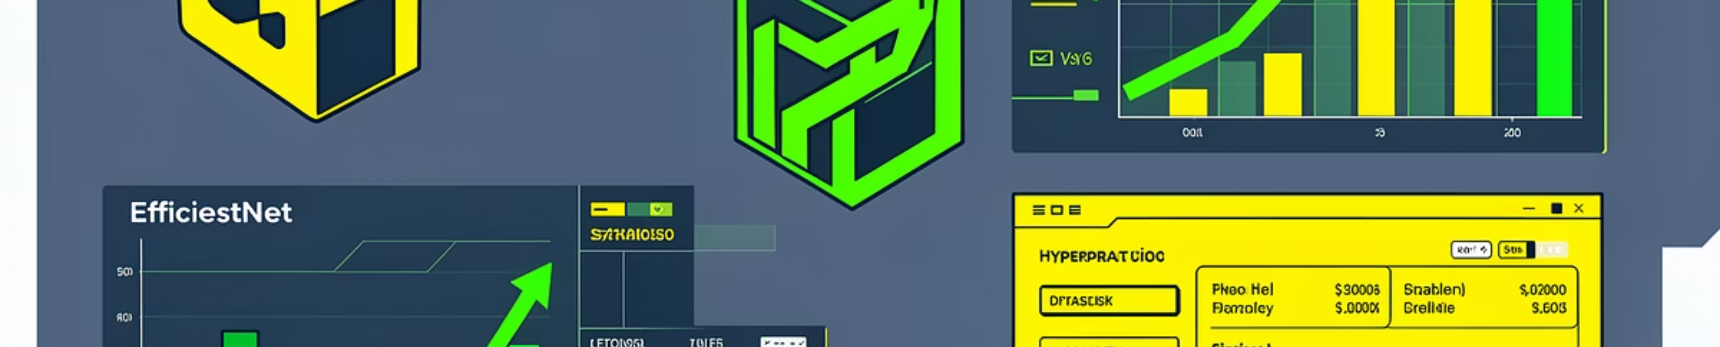
Conclusions & Next Steps
Conclusion
Future Work
Visuals to Add
VGG16 (transfer learning) produced the best results: top accuracy and metrics due to pretrained feature extraction.
Try ResNet50 / EfficientNet, expand dataset, fine-tune pretrained layers, hyperparameter optimization, add confusion matrices and exact performance tables.
Training accuracy/loss and per-model precision/recall/F1 graphs; optionally include code snippets and confusion matrices.

